Slide 1

The library app
B050-B048-B056

Slide 2
What is the problem ?
We have a lot of libraries in our city to provide a lot of books.
But a lot of times we suffer the problem of unavailability of the books and we don't know which book is available and when.

Slide 3
Possible solution
We looked into the issue and thought what if we have an app which can tell us which book is available and where.
And if its not available,then when it is going to be available.
This is what our app is all about.

Slide 4
The features
Accounts for every user registering for a particular library.
The user can check the availability of the books ,if it is available ,it can tell you where.
If the book is not available ,it can tell you when it will be available ,and notify you when it is available.
All you have to do is set a Wishlist of your favorite books and the app notifies you when it is available.
When you are in the library, you can issue the book through the app itself. No need to fill up information in the file.
Once you have issued the book ,the app also reminds you when the due date of the book is near.

Slide 5
How does it work?
We set up a server which contains the information of every book in a particular library with its availability.
This availability is set by the administrator of the library.
When the user searches for the book that is unavailable, and adds it into the Wishlist ,we set a flag in the app ,so if the book becomes available,the flag is raised and the user gets notified.
During the issue of the book ,the app generates a QR code for the administrator which contains the user ID.
The administrator scans the barcode of the book and the QR code of the user ,and an entry to the database is made which contains the user ID ,book ID ,and the time and date of the issue.
We will also calculate the due date and set a reminder in the users phone.

Slide 6
Our alpha app
As we are still learning the various features of the android studio,we have implemented the registering and verification of a user by a database.
As well as the book catalog can be made (also from a database) with a grid view and you can check the :
Book Name
Author
Description
Rating
Availability

Slide 7
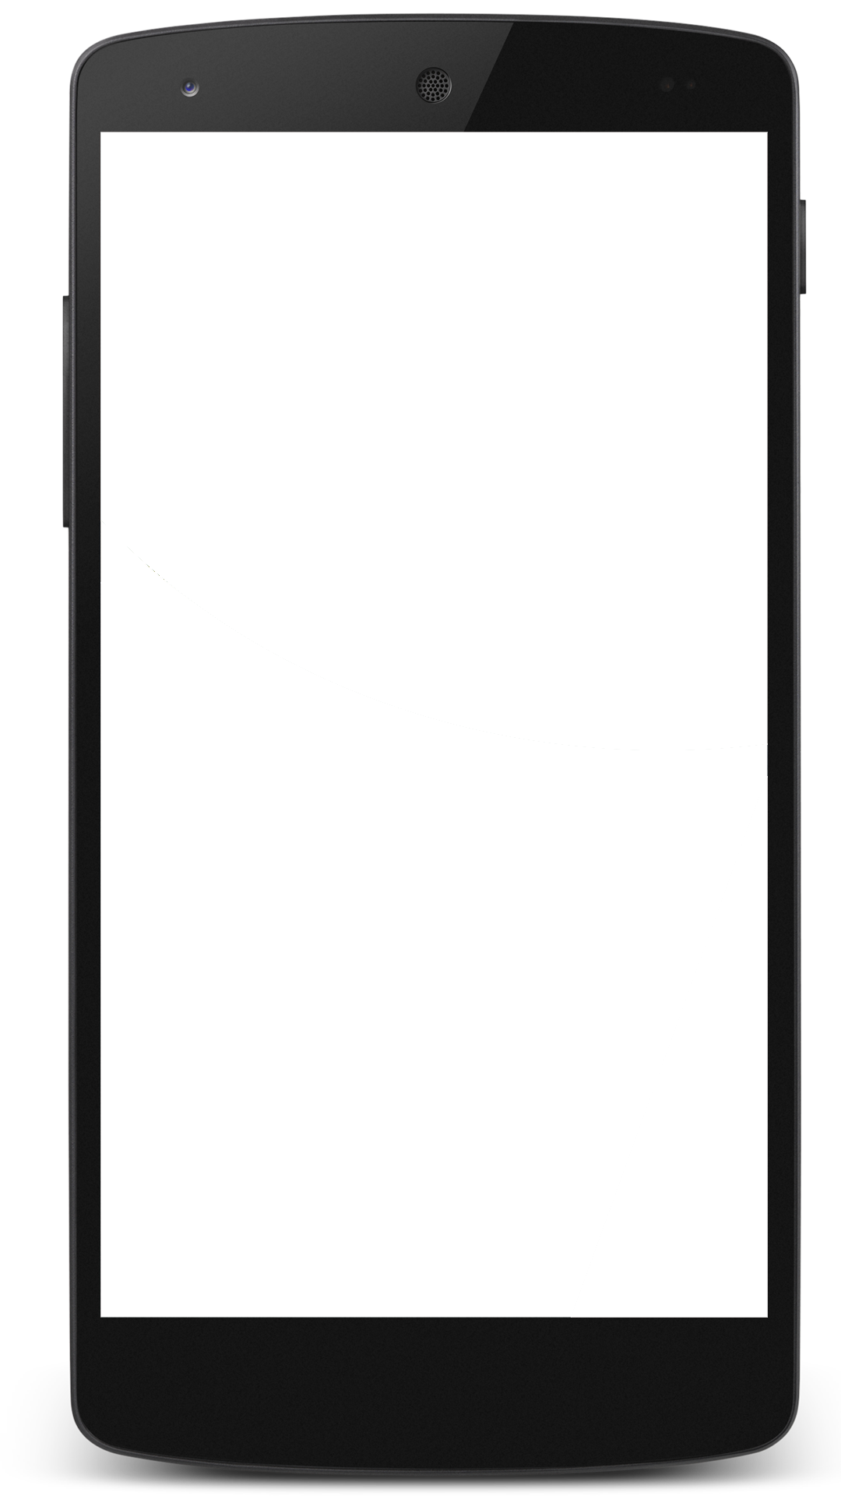
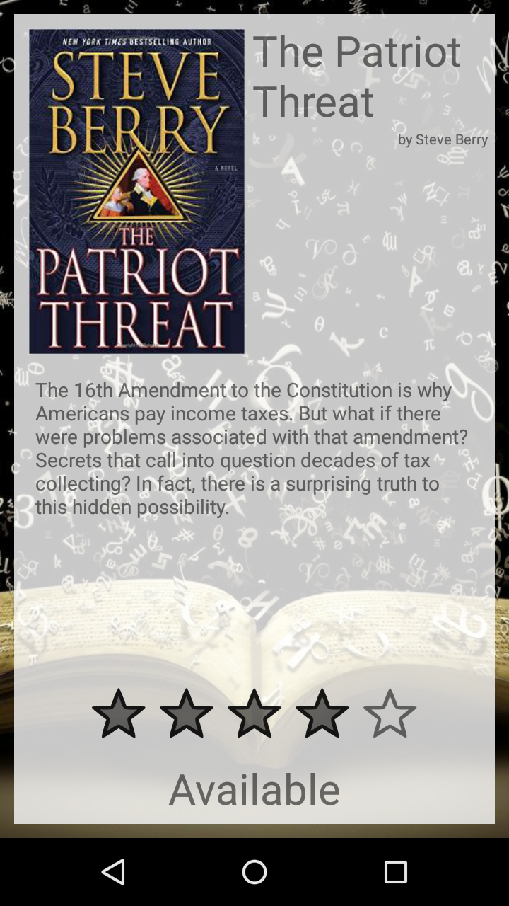
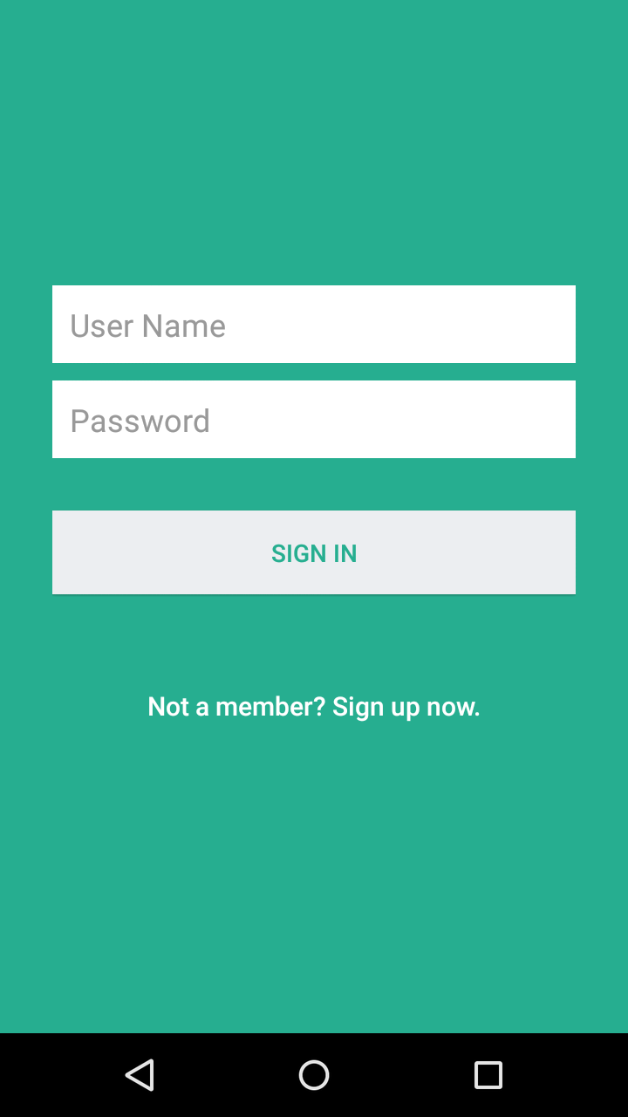
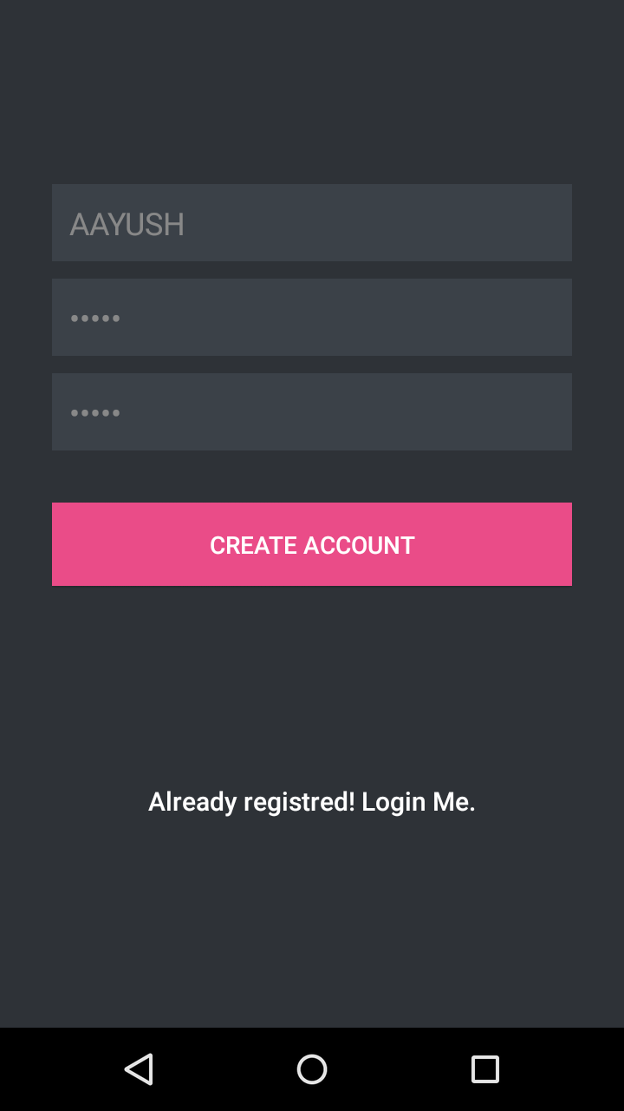
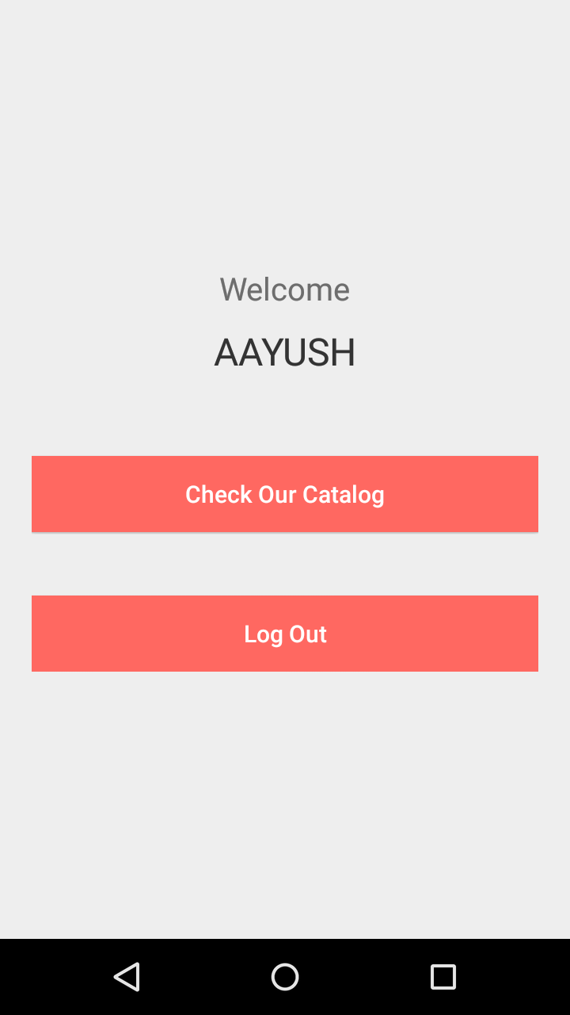

DEMO

Slide 8
Future Scope
Global Platform for library
Server Implementation
Multiple Library Approach
Near Me
Book Delivery and Collection

Slide 9
Thank you
B050-Dishant Kaushik
B048-Zoher Kachwala
B056-Aayush Sharma

